Slide 1


SMART INDIA HACKATHON 2024
Problem Statement ID – 1702
Problem Statement Title- Bail Reckoner
Theme- Smart Automation
PS Category- Software
Institute
Name:
AJAY
KUMAR
GARG
ENGINEERING COLLEGE
Team Name- Pixies Team ID- T126

Slide 2



Pixies
Key Challenges
Enhanced Efficiency Informed Decisions Increased Transparency
Judicial Support
Legal Empowerment
Undertrial Prisoners
Lack of Clarity
Legal Aid Providers:
Uncertainty in Process
PROBLEMS
Inaccurate Applications
Judicial Authorities:
Information Gaps
Inefficient Evaluation Decision Challenges
FEATURES SIGNIFICANCE
Inefficient Tracking Lack of Accessible Legal Information Bail Procedural Delays Lack of Integration with Judicial Risk Assessment
Legal Assistance
Legal Professional Interface
Bail Eligibility Monitoring Judicial Dashboard Risk Assessment Tools Bail Application Generator
LIMITATIONS
ctrl+click for VIDEO EXPLANATION

Slide 3














TECHNICAL APPROACH
Pixies
Features
Imprisonment tracker
Bail
Eligibility
Legal
Assistant
Input
Case
Prepare
Bail
Login
App Interface
Common Features
Prisoner
Bail Eligibility
Legal
Assistant
Login
Lawyer Features
OPEN-AI LLM
Lawyer
Login
Prisoner History
Prisoner
History
Access
Bail
Judge Features
using CNR number
Click here for DETAIL PROTOTYPES
Judge
Login & Authentication
Saving and retrieving
Saving and retrieving
Ctrl+click for FlOWCHART
MongoDB
Firebase
3

Slide 4

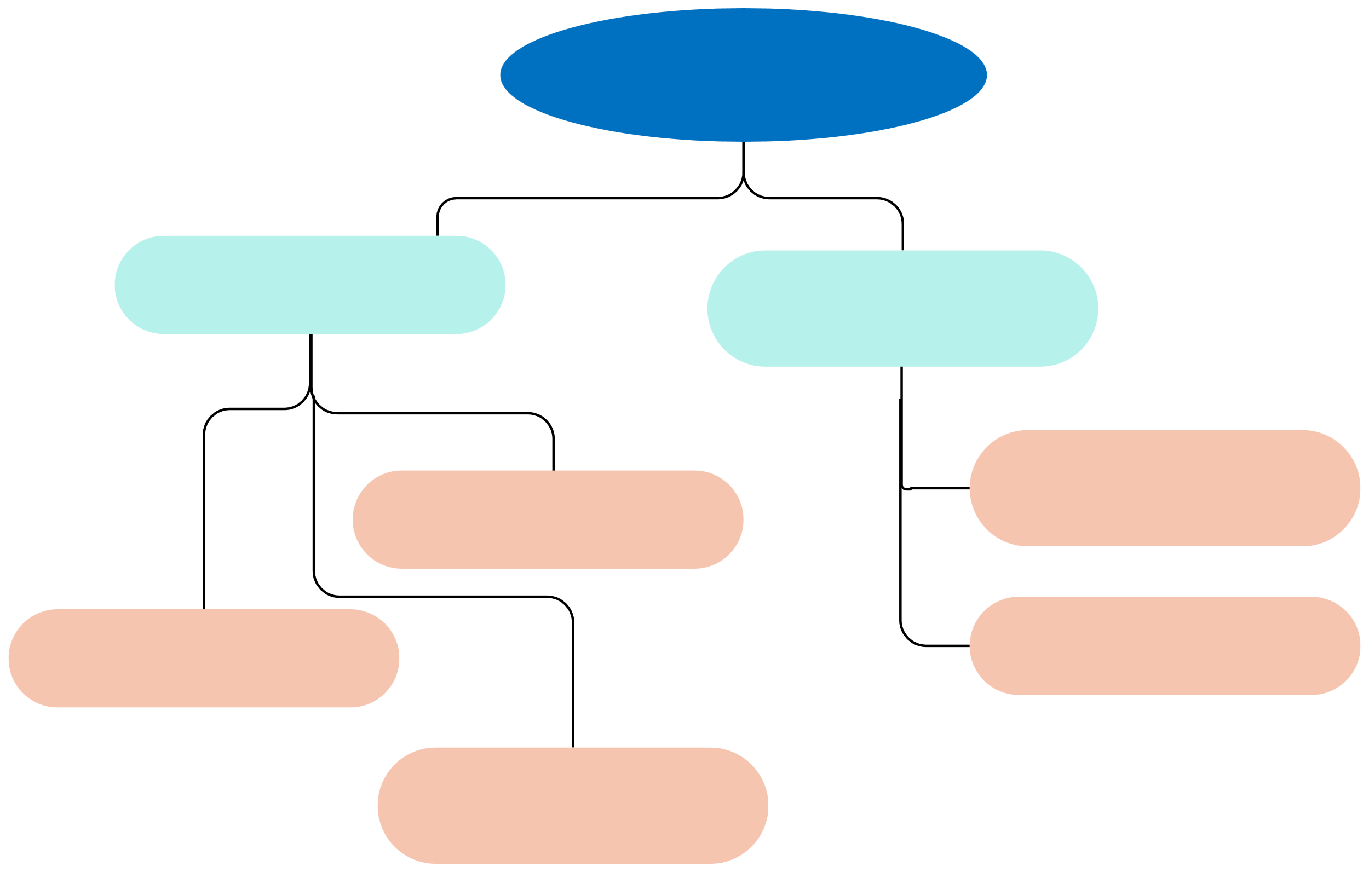
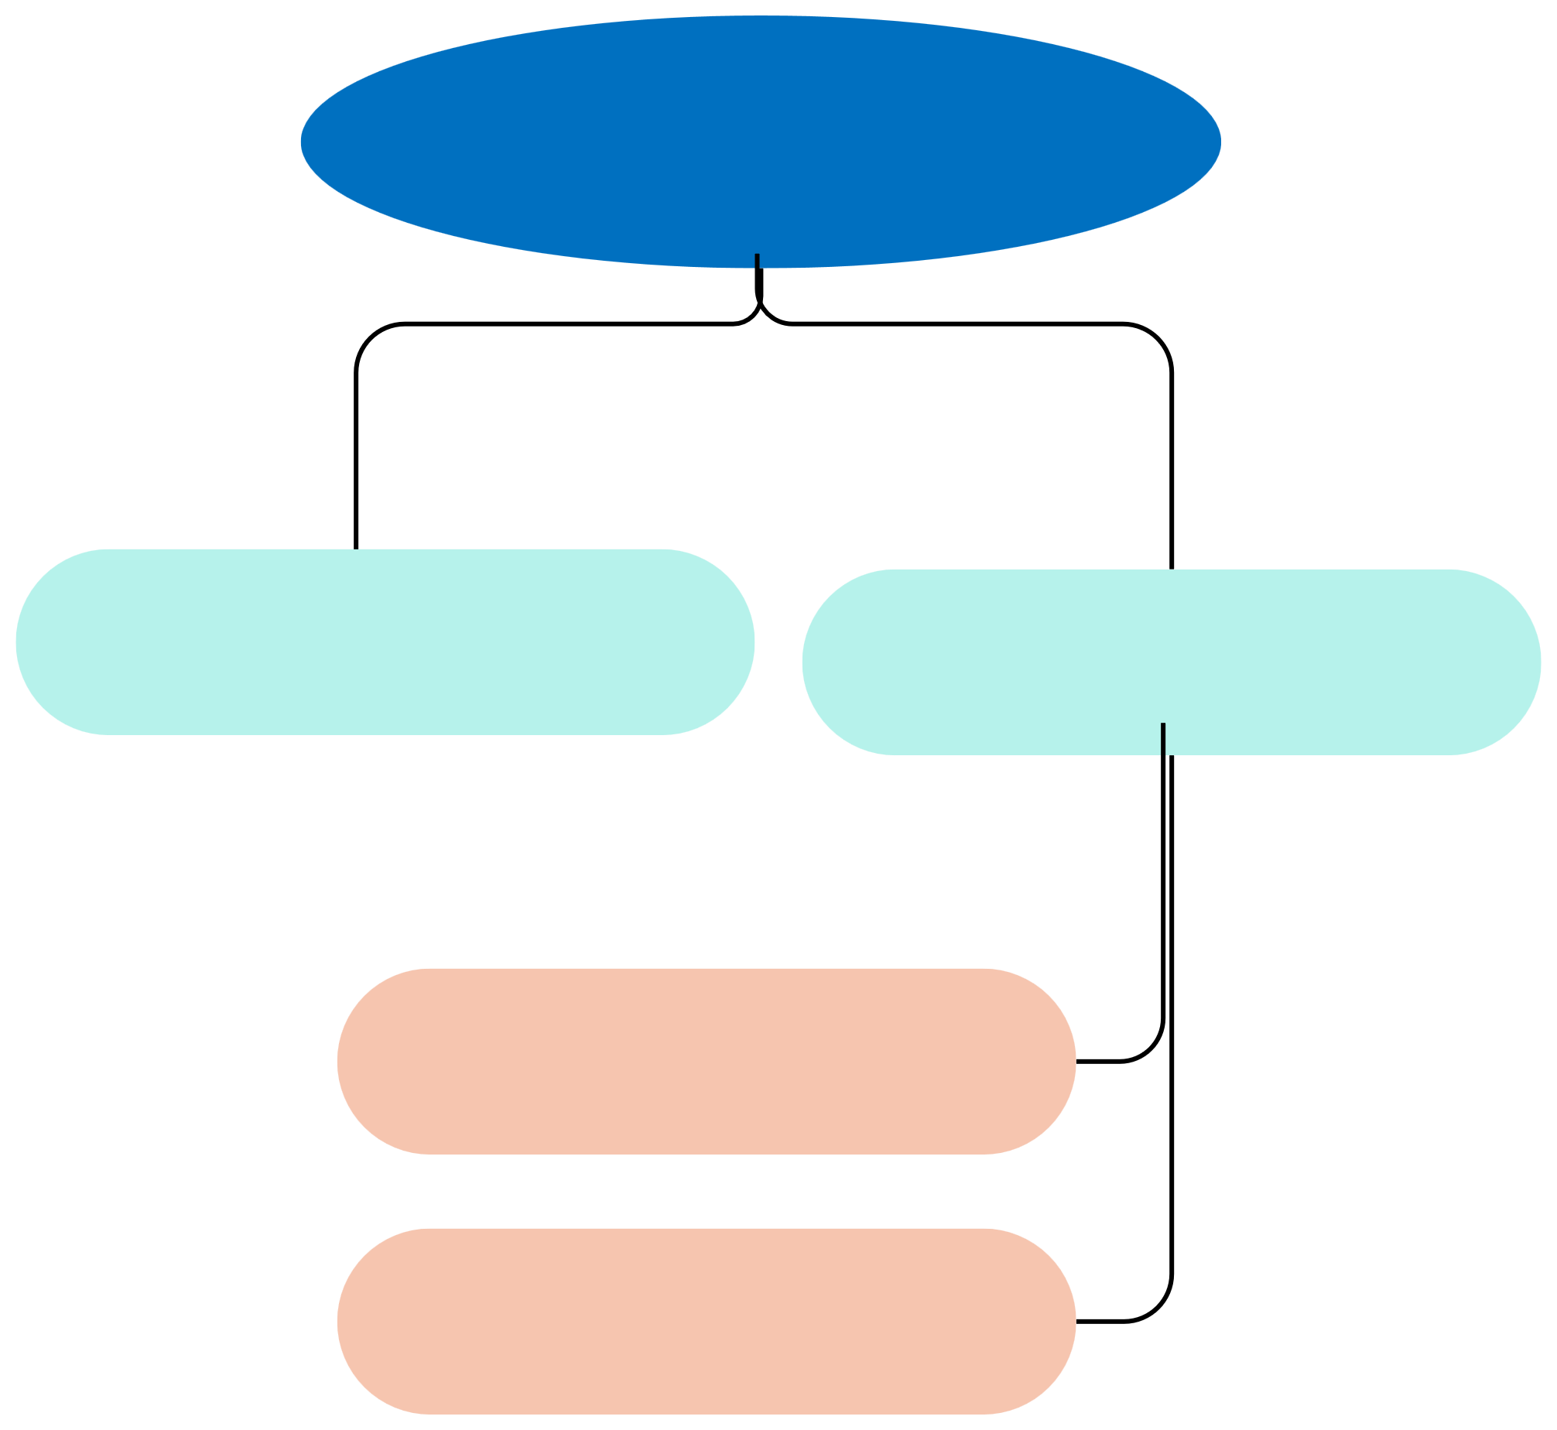
Pixies
FEASIBILITY AND VIABILITY
FEASIBILITY
VIABILITY
Technical Feasibility
Operational Feasibility
Market Demand
Sustainability
Judicial Collaboration
Data Integration
Continuous Updates
User Interface:
Scalability
Legal Adoption
Encryption and Security

Slide 5

BENEFITS AND IMPACT
Pixies
Benefits
Impacts
Social Benefits :
Undertrial Prisoners :
Empowerment
Faster Release Informed Decision-Making
Access to Justice Reduced Overcrowding
Judicial Authorities :
Economic Benefits :
Efficient Resource Allocation Cost Savings
Efficiency Informed Judgments
Environmental Benefits :
Legal Aid Providers:
Digital Transformation Energy Efficiency
Improved Accuracy
Streamlined Workflow :

Slide 6
RESEARCH AND REFERENCES
Pixies
Legal Statutes and Acts
Indian Penal Code (IPC), 1860 Bhartiya Nyaya Sanhita, 2023
Protection of Children from Sexual Offences Act, 2012
The Scheduled Castes and the Scheduled Tribes (Prevention of
Atrocities) Act, 1989
Ministry of home affairs
India Code
Dataset
NJDG
Indian kanoon

